Slide 1
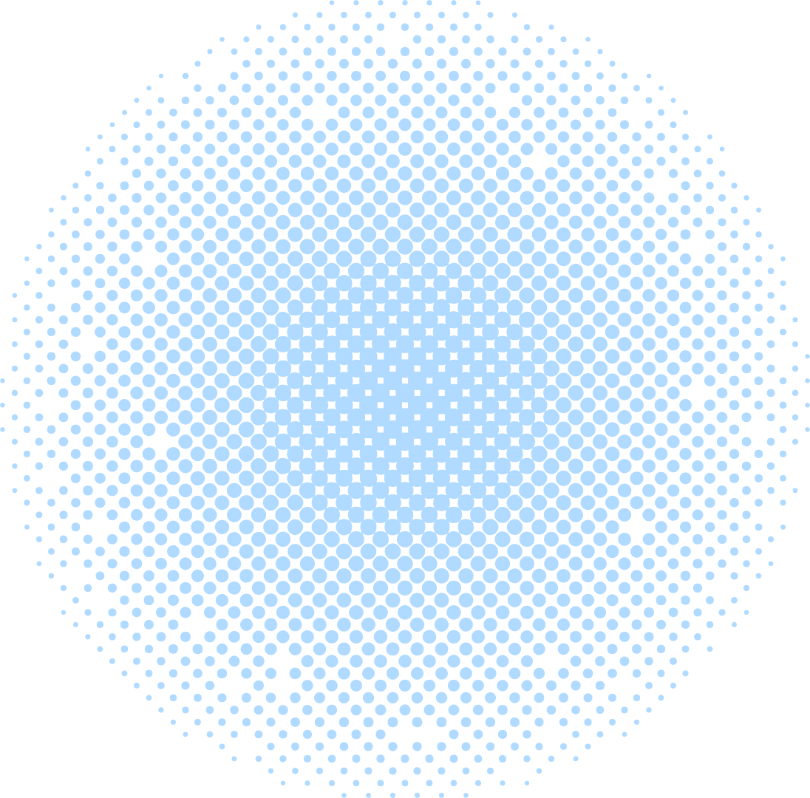

Diffusion-Based Garment Synthesis via Knowledge Graph-Driven Structural Cross-Modal Semantic Alignment
Miao-Yin Chen, Shu-Han Chuang
Department of Data Science, Soochow University, Taipei, Taiwan

Slide 2


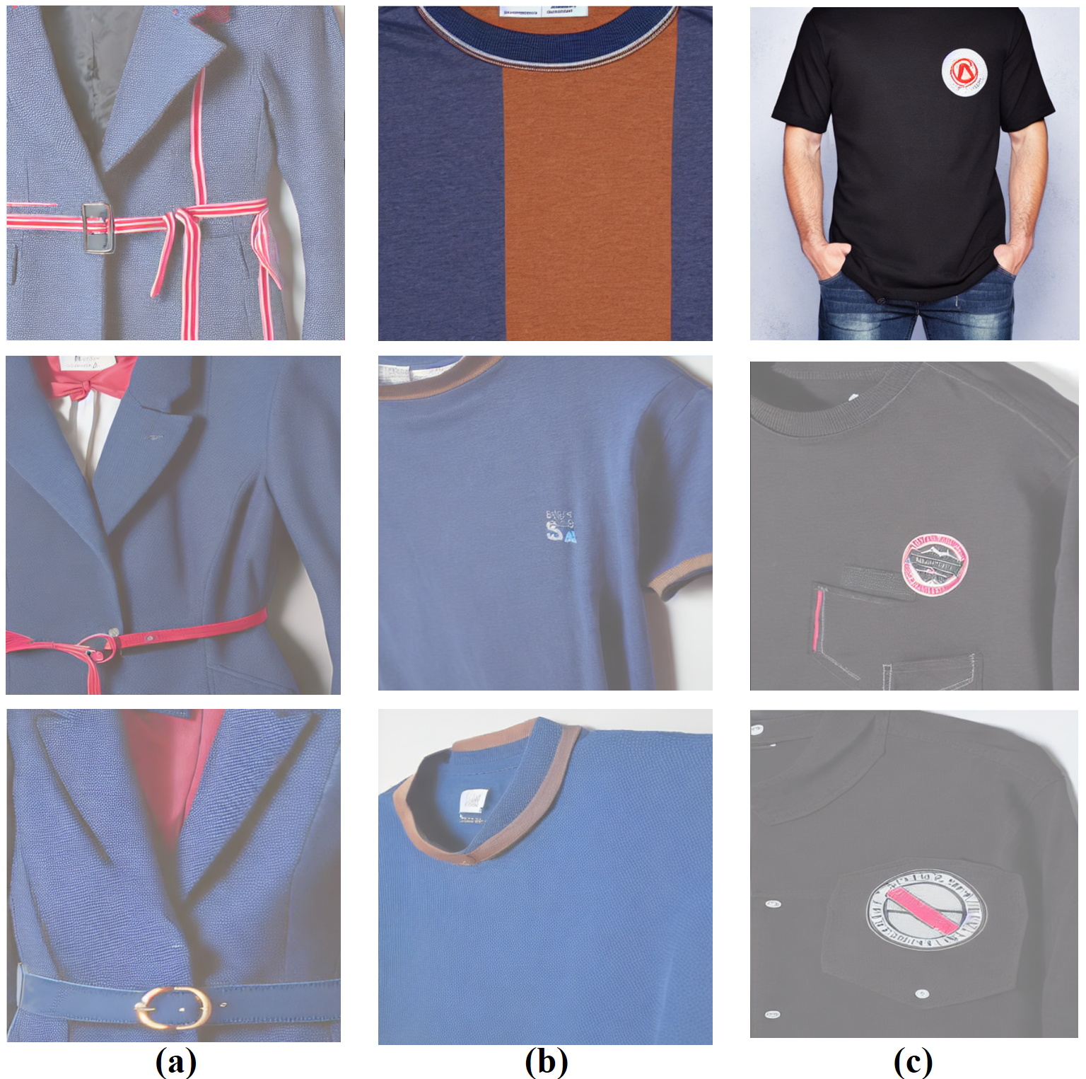

OVERVIEW
AI-driven garment synthesis transforms fashion design.
Text Prompt
Semantic drift
Attribute confusion
Regional inconsistencies
Challenges
Knowledge graph-driven diffusion model for enhanced control and alignment.
Generate
New Image
Our solution
Improve semantic fidelity and structural precision in garment synthesis.
Objective

Slide 3
Problems
Misalignment between text prompts and visual outputs.
Semantic drift
Challenges
in Garment Synthesis
Incorrect assignment of colors, patterns, or styles.
Attribute confusion
Unintended modifications to garment regions.
Regional inconsistencies
Limitations
of Existing Models
Unstable training, model collapse, limited structural control.
Generative Adversarial Networks

Slide 4

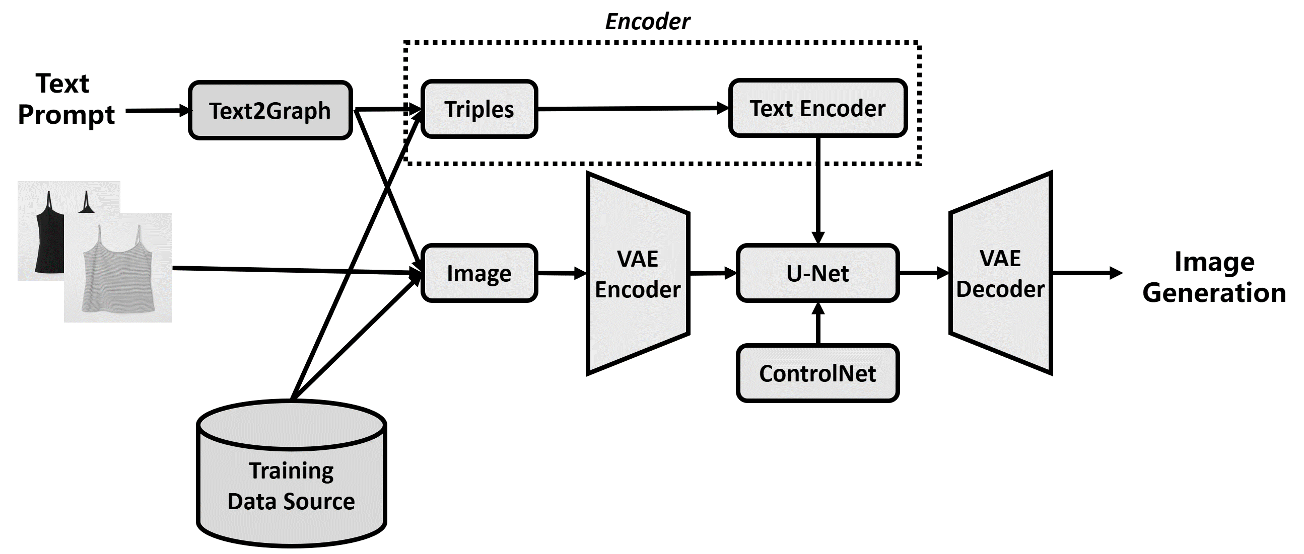


Proposed Approach
Text2Graph Module
01.
Converts natural language into semantic triples
Use LLM to encode triples into text embedding
We propose a knowledge graph-driven diffusion model to enhance control and alignment in garment synthesis
(jacket, has-color, navy blue),
(jacket, has-feature, collar),
(collar, has-style, straight-point),
(collar, has-color, red),
(jacket, has-feature, waist),
(waist, has-color, blue)
“a navy blue jacket with a red straight-point collar and a blue belted waist.”
Stable Diffusion
02.
Fine-tuned with LoRA for fashion-specific tasks.
ControlNet
03.
Incorporates structural inputs (pose, sketches) to ensure the generated images maintain spatial association.

Slide 5
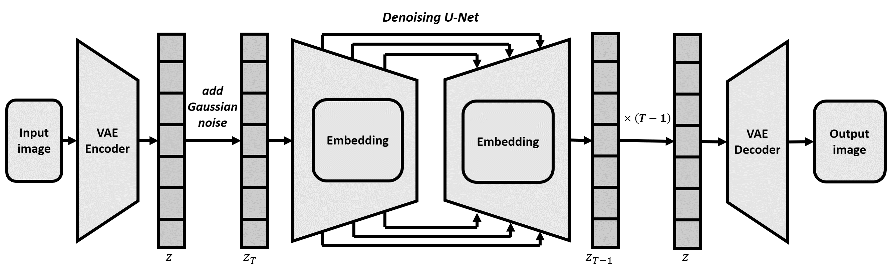
Diffusion-Based Garment Synthesis
Forward phase:
Adds Gaussian noise to images.
Reverse phase:
U-Net iteratively removes noise to reconstruct images.
VAE:
Compresses images into latent space for efficiency.
High-fidelity garment images with accurate textures, shapes, and colors.

Slide 6




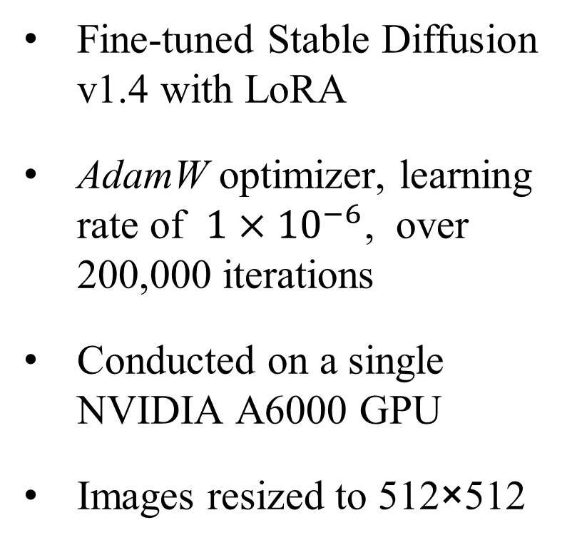
Experiments
01.
02.
03.
Datasets
Parameters Setting
Evaluation Metrics
H&M Personalized Fashion Recommendations dataset from Kaggle competition (approx. 105,000 images)
Fine-tuned Stable Diffusion v1.4 with LoRA
AdamW optimizer, learning rate of $1×{10}^{−6}$, over 200,000 iterations
Conducted on a single NVIDIA A6000 GPU
Images resized to 512×512
CLIP Score |  | Text-image semantic alignment.
Fréchet Inception Distance (FID) |  | Visual realism
Inception Score (IS) |  | Image quality and diversity.

Slide 7
Results
Model | CLIP Score | FID Score | Inception Score
Stable diffusion | 31.54 | 290.15 | 1.76
Fine-tuned Stable diffusion | 28.56 | 275.35 | 1.89
KG-driven Stable diffusion | 29.28 | 255.90 | 1.86
Higher CLIP Score | = | Better Text-Image Alignment
Lower FID | = | Better Visual Realism
Higher IS | = | Better Quality & Diversity
CLIP Score
Our approach shows a modest improvement over the fine-tuned model, but lower than base model.
Knowledge graph-driven text triple prompt are structurally concise but semantically sparse.
→ The original pretrained CLIP model was not trained on structured triples, it fails to fully understand input triples, even if the image is semantically correct.

Slide 8
Results
Model | CLIP Score | FID Score | Inception Score
Stable diffusion | 31.54 | 290.15 | 1.76
Fine-tuned Stable diffusion | 28.56 | 275.35 | 1.89
KG-driven Stable diffusion | 29.28 | 255.90 | 1.86
Higher CLIP Score | = | Better Text-Image Alignment
Lower FID | = | Better Visual Realism
Higher IS | = | Better Quality & Diversity
FID Score
Our approach achieves a notably lower FID, indicating a closer alignment with the distribution of real images and reflecting superior visual realism.

Slide 9
Results
Model | CLIP Score | FID Score | Inception Score
Stable diffusion | 31.54 | 290.15 | 1.76
Fine-tuned Stable diffusion | 28.56 | 275.35 | 1.89
KG-driven Stable diffusion | 29.28 | 255.90 | 1.86
Higher CLIP Score | = | Better Text-Image Alignment
Lower FID | = | Better Visual Realism
Higher IS | = | Better Quality & Diversity
Inception Score
Our approach attains a higher Inception Score, demonstrating improved image quality and greater intra-class diversity.
Both fine-tuned model and our approach achieve better IS than the original Stable Diffusion v1.4 baseline → Fine-tuning process may lead to better results.

Slide 10



Results
Input prompt:
“A navy blue jacket with red straight-point collar and blue belted waist”
Stable diffusion
Navy blue jacket
Red straight-point collar
Blue belted waist
Fine-tuned Stable diffusion
Navy blue jacket
Red straight-point collar
Blue belted waist
KG-driven Stable diffusion
Navy blue jacket
Red straight-point collar
Blue belted waist

Slide 11
Results
Input prompt:
“a blue shirt with brown collar”
Stable diffusion
Blue shirt
Brown collar
Fine-tuned Stable diffusion
Blue shirt
Brown collar
KG-driven Stable diffusion
Blue shirt
Brown collar

Slide 12
Results
Input prompt:
“Black cotton shirt with chest patch pocket, round neck, and featuring logo patch at the chest,”
Stable diffusion
Black cotton shirt
Chest patch pocket
Round neck
Logo patch
Fine-tuned Stable diffusion
Black cotton shirt
Chest patch pocket
Round neck
Logo patch
KG-driven Stable diffusion
Black cotton shirt
Chest patch pocket
Round neck
Logo patch

Slide 13
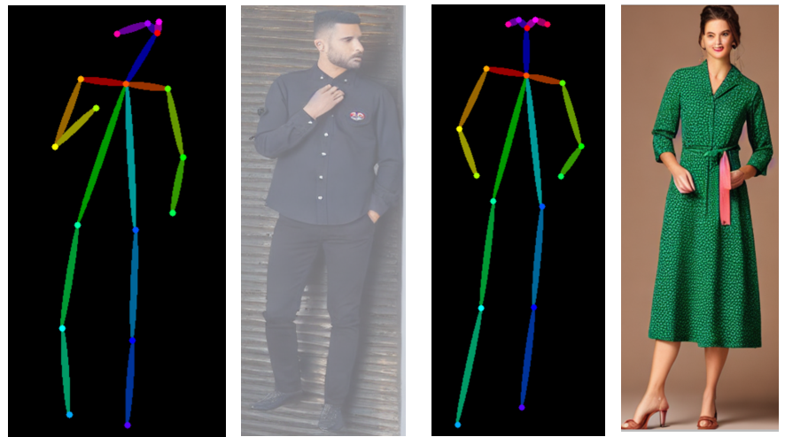
Pose-controlled garment synthesis
Our approach combines OpenPose with knowledge graphs for precise pose and attribute alignment.
By using OpenPose, it can accurately replicate the exact body pose of the input image.

Slide 14


Conclusion
Key Achievements
Limitations
Knowledge graph-driven framework enhances semantic fidelity and controllability.
Superior performance in visual realism and text-image alignment.
Sensitivity to noisy text inputs.
Challenges with long, ambiguous prompts.

Slide 15
Thank you

